Slide 1

PRESENTATION
On
Quantum Computing -
Next Generation of Computing Devices…..
Submitted By :
ANURAG ANAND
(1AY12EC014)
Under the Guidance:
Dr. Rajeswari
HOD ECE
DEPARTMENT OF ELECTRONICS AND COMMUNICATION
27th February,2016

Slide 2
Overview
Introduction
History
What is Quantum Computers
Need for quantum computer
What special about quantum computer
Quantum Computing Power
Classical vs Quantum
Need for the speed….
Applications of quantum computer
Challenges and Limitations
Summary
References

Slide 3
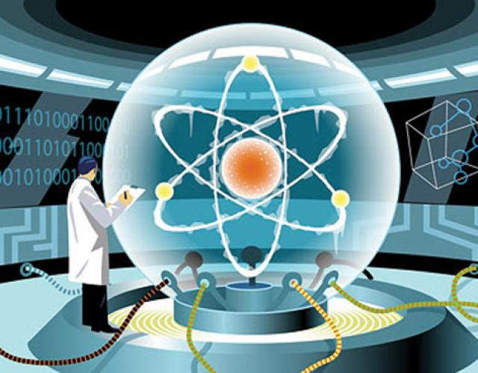
INTRODUCTION
Quantum computers use atoms to perform calculation
Here computation depends on principle of quantum theory.
Qubit

Slide 4
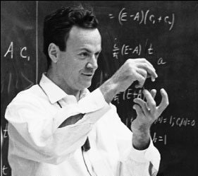
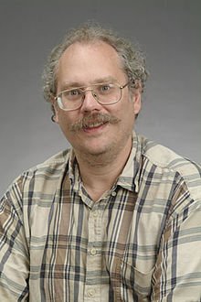
HISTORY
1982 - Fey man proposed the idea of creating machines based on the laws of quantum mechanics.
1985 - David developed the quantum Tuning machine, showing that quantum circuits are universal.
1994 - Peter Shor -quantum algorithm to factor very large numbers in polynomial time.

Slide 5
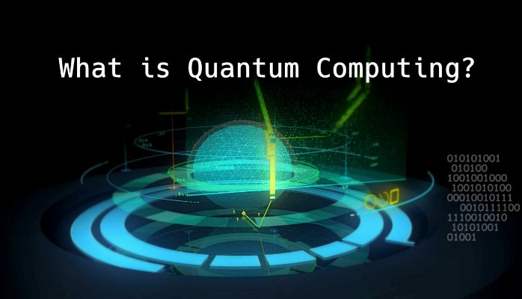
What is a Quantum Computer?
Quantum Computer
  A computer that uses quantum mechanical phenomena to perform operations on data through devices such as superposition and entanglement.

Slide 6
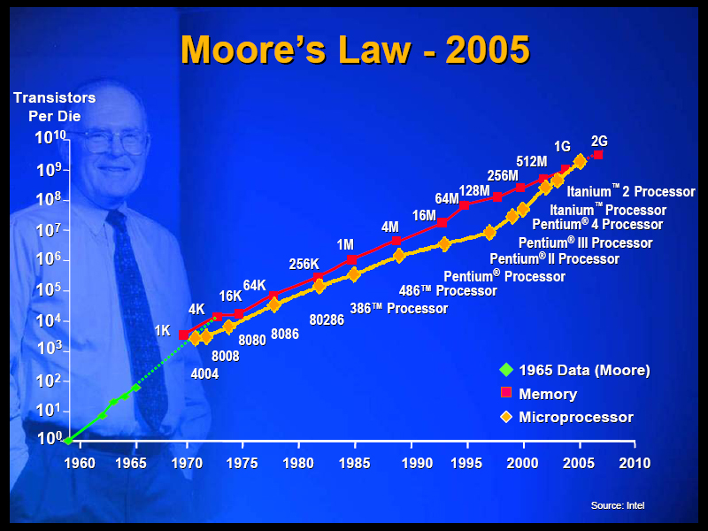
Need for quantum computer
Moore’ law slowing down in 2020 it is flattened out.
Transistor cannot be made smaller , to avoid Moore's law.
Post silicon era

Slide 7
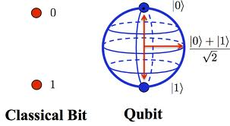
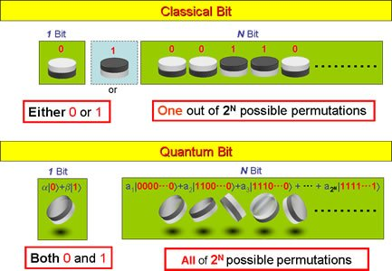
What special about Quantum computer

Slide 8
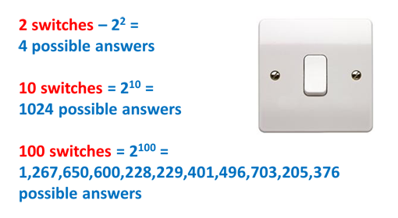
Quantum Computing Power
Quantum Database Search
  Example: To search the entire Library of Congress for one’s name given an unsorted database...
    Classical Computer – 100 years
    Quantum Computer – ½ second

Slide 9
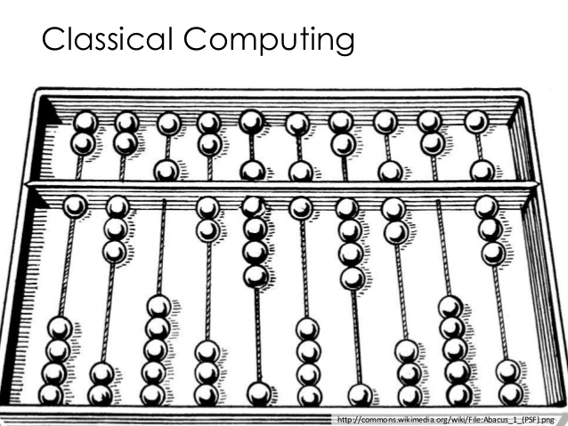
What is classical computer?
Classical Computer (Binary)
A computer that uses voltages flowing through circuits and gates, which can be calculated entirely by classical mechanics

Slide 10
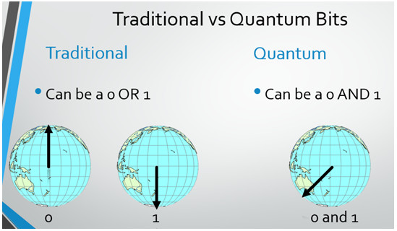
Classical vs. Quantum Bits
Classical Bit
  2 Basic states – off or on: 0, 1
  Mutually exclusive
Quantum Bit (Qubit)
  2 Basic states – key 0, key 1:
  Superposition of both states -
  (not continuous in nature)

Slide 11
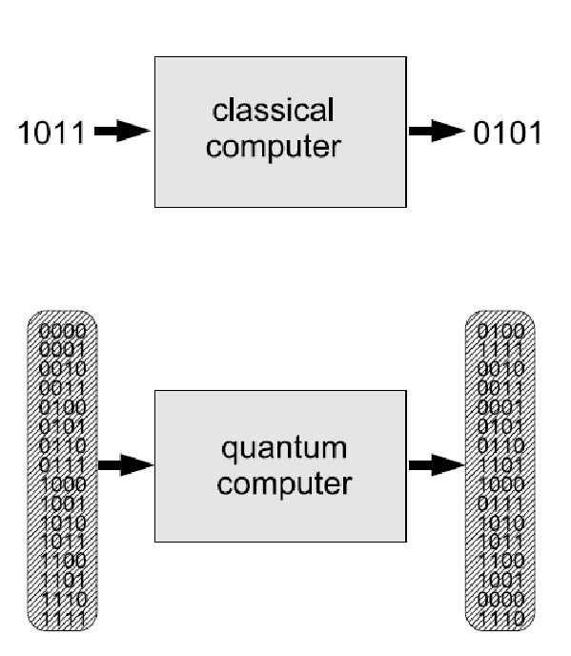
The Need For Speed...
Classical Digital Computer
  Moore’s Law: transistors on chip doubles every 18 months—microprocessor circuits will measure on atomic scale by 2020-2030
  Serial Processing – one operation at a time
Quantum Computer
  Harnesses the power of atoms and molecules to perform memory and processing tasks
  Parallel Processing – millions of operations at a time

Slide 12
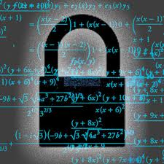
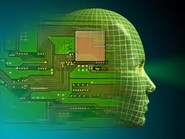
APPLICATIONS
Cryptography
Artificial intelligence
Teleportation
Quantum communication

Slide 13
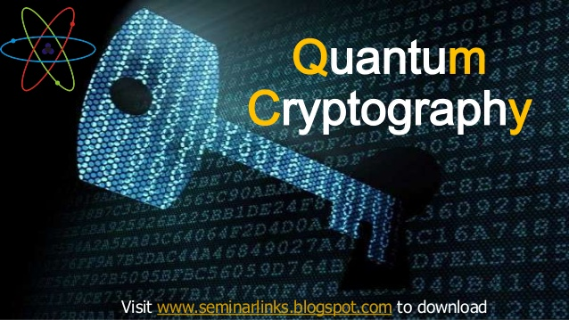
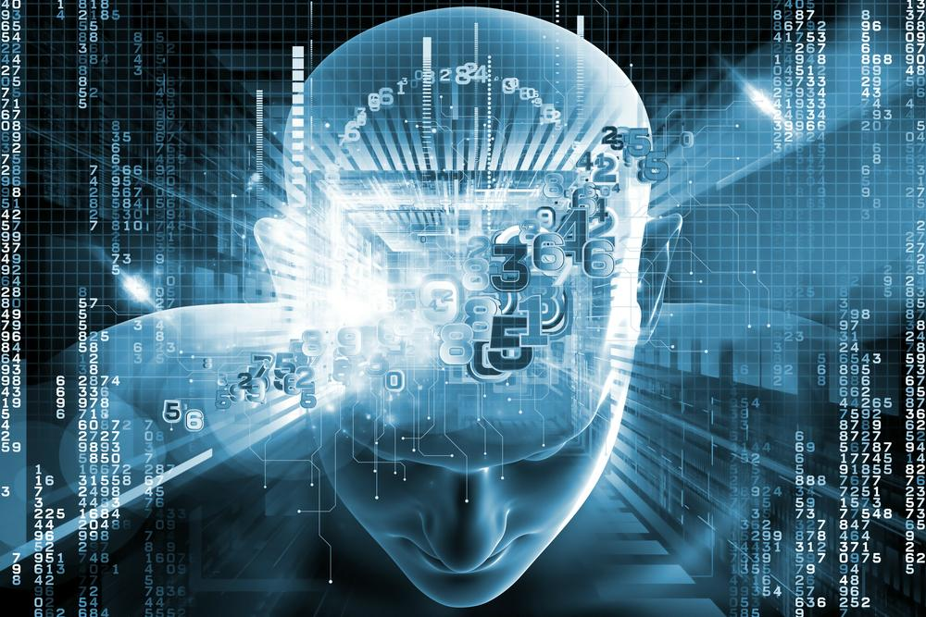
Practical Quantum Computer Applications
Cryptography
  Cryptography is a method of storing and transmitting data in a particular form so that only those for whom it is intended can read and process it.
  Artificial Intelligence
  Artificial intelligence is the branch of computer science concerned with making computers behave like humans.

Slide 14

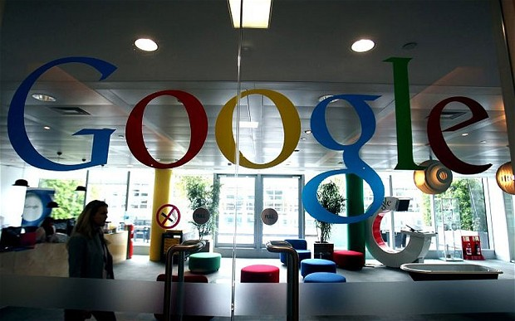
Organisations using Quantum Computing

Slide 15
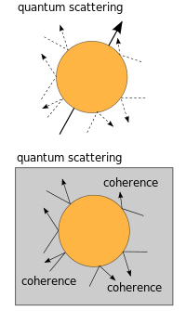
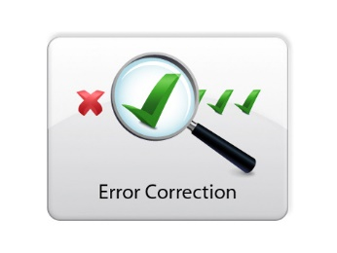
Challenges and Limitations
Decoherence
Error correction
Cost

Slide 16
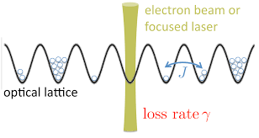
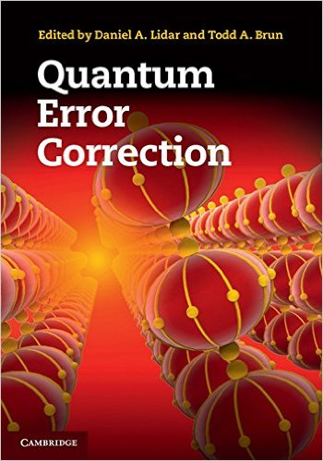
Quantum Computing limitations
  Decoherence -
  quantum decoherence is the loss of coherence , Decoherence can be viewed as the loss of information from a system into the environment
  Error correction –
  Quantum error correction is used in quantum computing to protect quantum information from errors due to decoherence and other quantum noise
  Recently Google Tested First Error Correction in Quantum Computing in 2014.

Slide 17
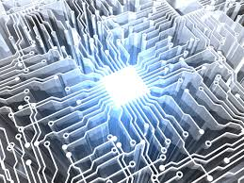
Summary
A quantum computer thus has the theoretical capability of simulating any finite physical system and may even hold the key to creating an artificially intelligent computer.

Slide 18
Research References
http://www.qubit.org
http://www.cs.caltech.edu/~westside/quantum-intro.html
http://computer.howstuffworks.com/quantum-computer1.html
http://en.wikipedia.org/wiki/Quantum_computers
http://www.carolla.com/quantum/QuantumComputers.html

Slide 19
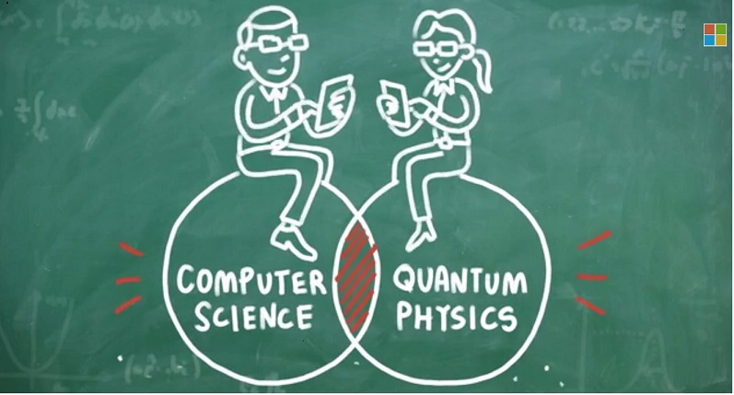
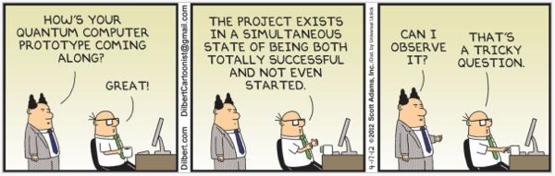
Life is strong and fragile. It's a paradox... It's both things, like quantum physics: It's a particle and a wave at the same time. It all exists all together.

Slide 20
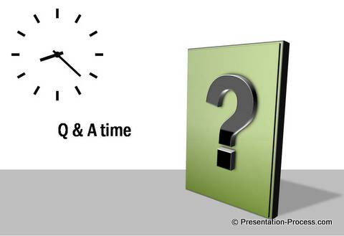
Queries?

Slide 21


