Slide 1
QUANTUM COMPUTING

Slide 2
Introduction to Quantum Computing
Quantum computing is a new and rapidly developing field in computer science that uses the principles of quantum physics to process information.
In Quantum computers information is stored and manipulated using single isolated atoms or photons or electrons. Since atoms, molecules and photons obey the law quantum mechanics.
Quantum computers perform computation and process information according to the laws of quantum mechanics. The novel features of these computers have immense potential applications in the ﬁeld of cryptography. (Cryptography is the science of maintaining secrecy and security in communication)

Slide 3
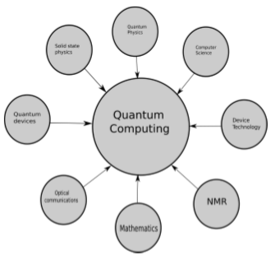
Disciplines contributes towards of quantum computation

Slide 4
Differences Between Classical and QuantumComputing
ClassicalComputing
Used by large scale, multipurpose and devices.
Information is stored in bits.
There is a discrete number of possible states. Either 0 or 1.
Calculations are deterministic. This means repeating the same inputs
results in the same output.
5. Data processing is carried out by logic and in sequential order.
6. Operations are governed by Boolean Algebra.
7. Circuit behavior is defined by Classical Physics.
QuantumComputing 1. Used by high speed, quantum mechanics-based computers.
2. Information is based on Quantum Bits.
3. The is an infinite, continuous number of possible states. They are the result of quantum superposition.
4. The calculations are probabilistic, meaning there are multiple possible outputs to the same inputs.
5. Data processing is carried out by quantum logic at parallel instances.
6. Operations are defined by linear algebra by Hilbert Space.
7. Circuit behavior is defined by Quantum Mechanics.

Slide 5

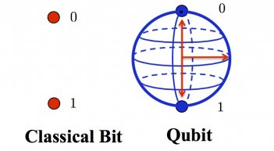

Concept of Qubits and itsProperties
What Is “Qubit”?

Slide 6
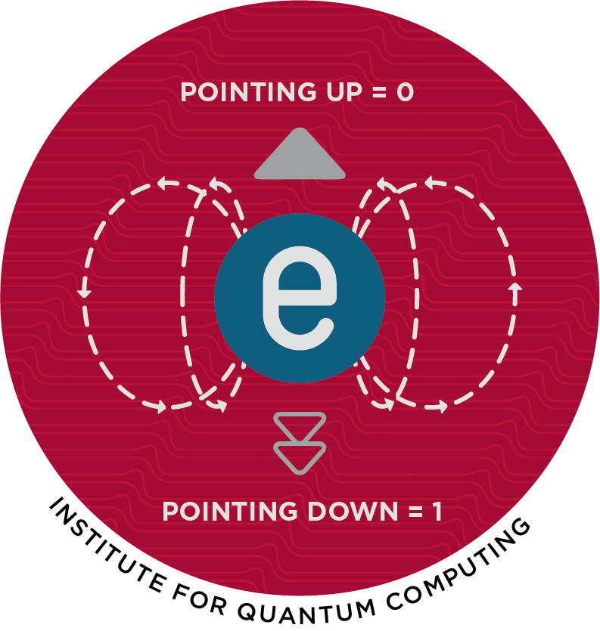
Implementations of a “Qubit”
Spin orientation of an electron
Most quantum particles behave like little magnets. We call this property spin. The spin orientation is always pointing either fully up or fully down but never in between. Using the spin states of up and down, we can build a spin qubit.
= pointing up, = pointing down

Slide 7
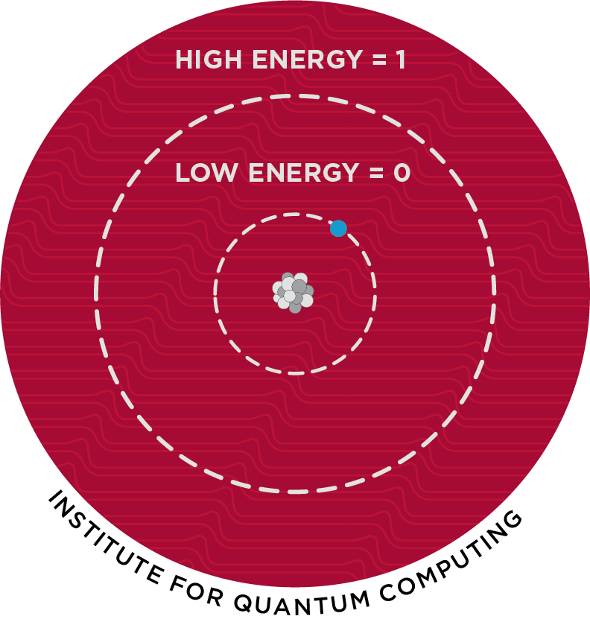
Energy level of an atom
We can use the energy levels of electrons in neutral atoms or ions as qubits. In their natural state, these electrons occupy the lowest possible energy levels. Using lasers, we can “excite” them to a higher energy level. We can assign the qubit values based on their energy state.
= low energy state, = high energy state

Slide 8
Contd..
The state of a qubit is enclosed in the right half of an angled bracket, called the “ket”.
A qubit, |ψ, could be in a or |1i state which is a superposition of both and |1.
This is written as,
|ψ = α + β Where α and β called the amplitude of the states which are a complex number.

Slide 9
Concept of Qubits and its Properties
A qubit, or quantum bit, is the fundamental unit of information in a quantum computer. Unlike classical bits, which can be in either the 0 or 1 state, qubits can exist in both 0 and 1 states at the same time, a property known as superposition. This means that a qubit can represent not just two, but an infinite number of possible states simultaneously, which makes quantum computers potentially much more powerful than classical computers for certain types of computations.
Another important properties of quantum computing are interference and entanglement.
Interference refers to wave properties adding and subtracting the magnitude which allows state manipulation.
Entanglement, which allows two or more qubits to be correlated in such a way that the state of one qubit can affect the state of another qubit, even if they are separated by large distances.

Slide 10
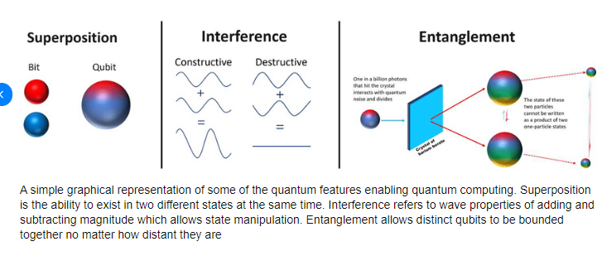
Contd..

Slide 11
Moore's Law and its End
This law is a prediction made by Gordon Moore, co-founder of Intel, in 1965 that the “number of transistors on a microchip would double approximately every two years”, leading to a rapid increase in computing power and a decrease in the cost per transistor.
On the other hand, the pace (speed) of progress in recent years has slowed down and some experts predict that the end of Moore's Law is near. This is because it is becoming increasingly difficult to manufacture transistors that are smaller and more densely packed, as the physical limits of silicon and other materials are reached. Additionally, power consumption and heat dissipation are becoming major challenges, as more transistors on a chip require more energy and generate more heat.

Slide 12
Contd..
In spite of this, there is still ongoing research and development aimed at extending Moore's Law and finding new ways to improve the performance of computer chips.
Some experts predict that novel materials and manufacturing techniques, such as graphene and nanotechnology, may play a role in extending the life of Moore's Law. However, it is also possible that the end of Moore's Law could lead to a slowdown in the rate of improvement in computing power, or a shift towards alternative technologies such as quantum computing.

Slide 13
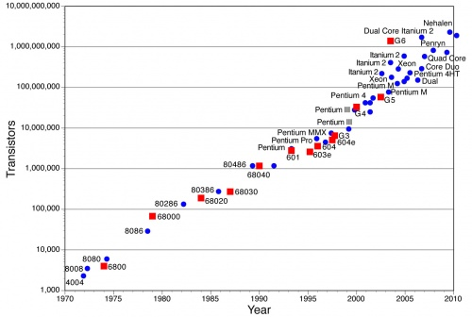
Moore’s law showing increasing number of transistors on silicon

Slide 14
Single Particle Quantum Interference
Quantum interference is a phenomenon that occurs when particles exhibit wave-like behavior and interfere with themselves. This interference can be observed in a single-particle system, such as a single photon passing through a double-slit experiment.
In the double-slit experiment, a single photon is sent through two parallel slits and the resulting interference pattern is observed on a screen. The interference pattern arises from the wave-like nature of the photon, as it passes through both slits and interferes with itself.
The interference pattern on the screen shows regions of bright fringes and dark fringes, which correspond to regions of constructive and destructive interference, respectively. The bright fringes occur where the waves from both slits reinforce each other, while the dark fringes occur where the waves cancel each other out.

Slide 15
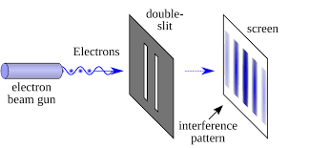
Here is a diagram illustrating the concept of single-particle quantum interference in a double-slit experiment:
In the diagram, a single photon is shown passing through two parallel slits and creating an interference pattern on the screen. The wave nature of the photon causes it to interfere with itself, creating regions of bright and dark fringes on the screen.
This interference pattern is a fundamental aspect of quantum mechanics and can be observed not only in single-particle systems, but also in larger systems such as molecules and even entire atoms. It is a key concept in understanding the strange and dual nature behavior of particles in the quantum world.

Slide 16
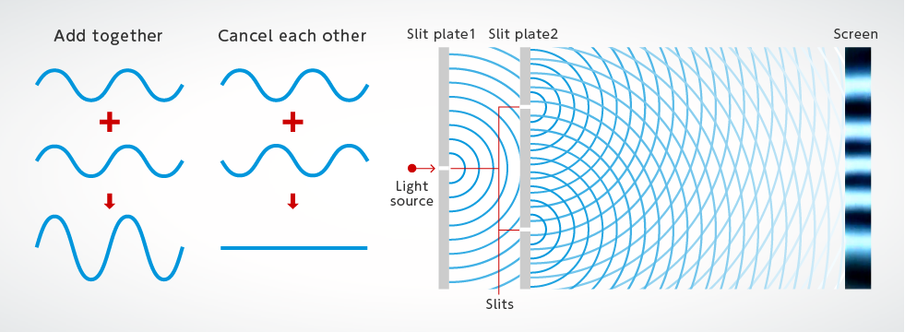
Interference Fringes

Slide 17
In a classical computer, a bit can only be in one of two states: 0 or 1. In a quantum computer, a qubit can exist in multiple states simultaneously, allowing it to process information in a more parallel manner. This allows quantum computers to perform certain calculations much faster and more efficiently than classical computers.

